Slide 1

NASA SPACE APPS CHALLENGE 2025
NEBULAEXO
Problem Statement Title – AI- Powered Exoplanet Detection and Habitability Using Open NASA Datasets
Team Name – Return 0
Member 1: Piyush Naula
Member 2: Piyush Palariya
Member 3: Rahul Joshi
Member 4: Rahul Bisht
Member 5: Samriddhi Gururani
Member 4: Mohd Hifzan

Slide 2
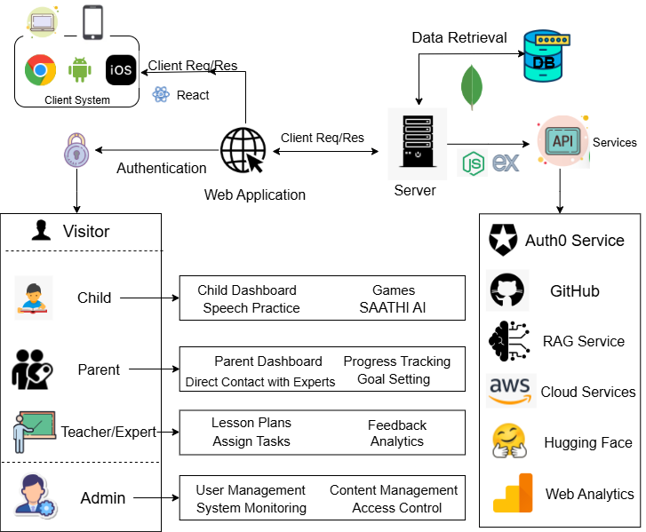
NEBULAEXO
Introduction:
Exoplanets are planets that exist outside our solar system
They orbit their host stars just like Earth orbits the Sun
NASA’s Kepler Mission collected large data to find such planets using light intensity variations
Manual detection of exoplanets is slow and time consuming

Slide 3

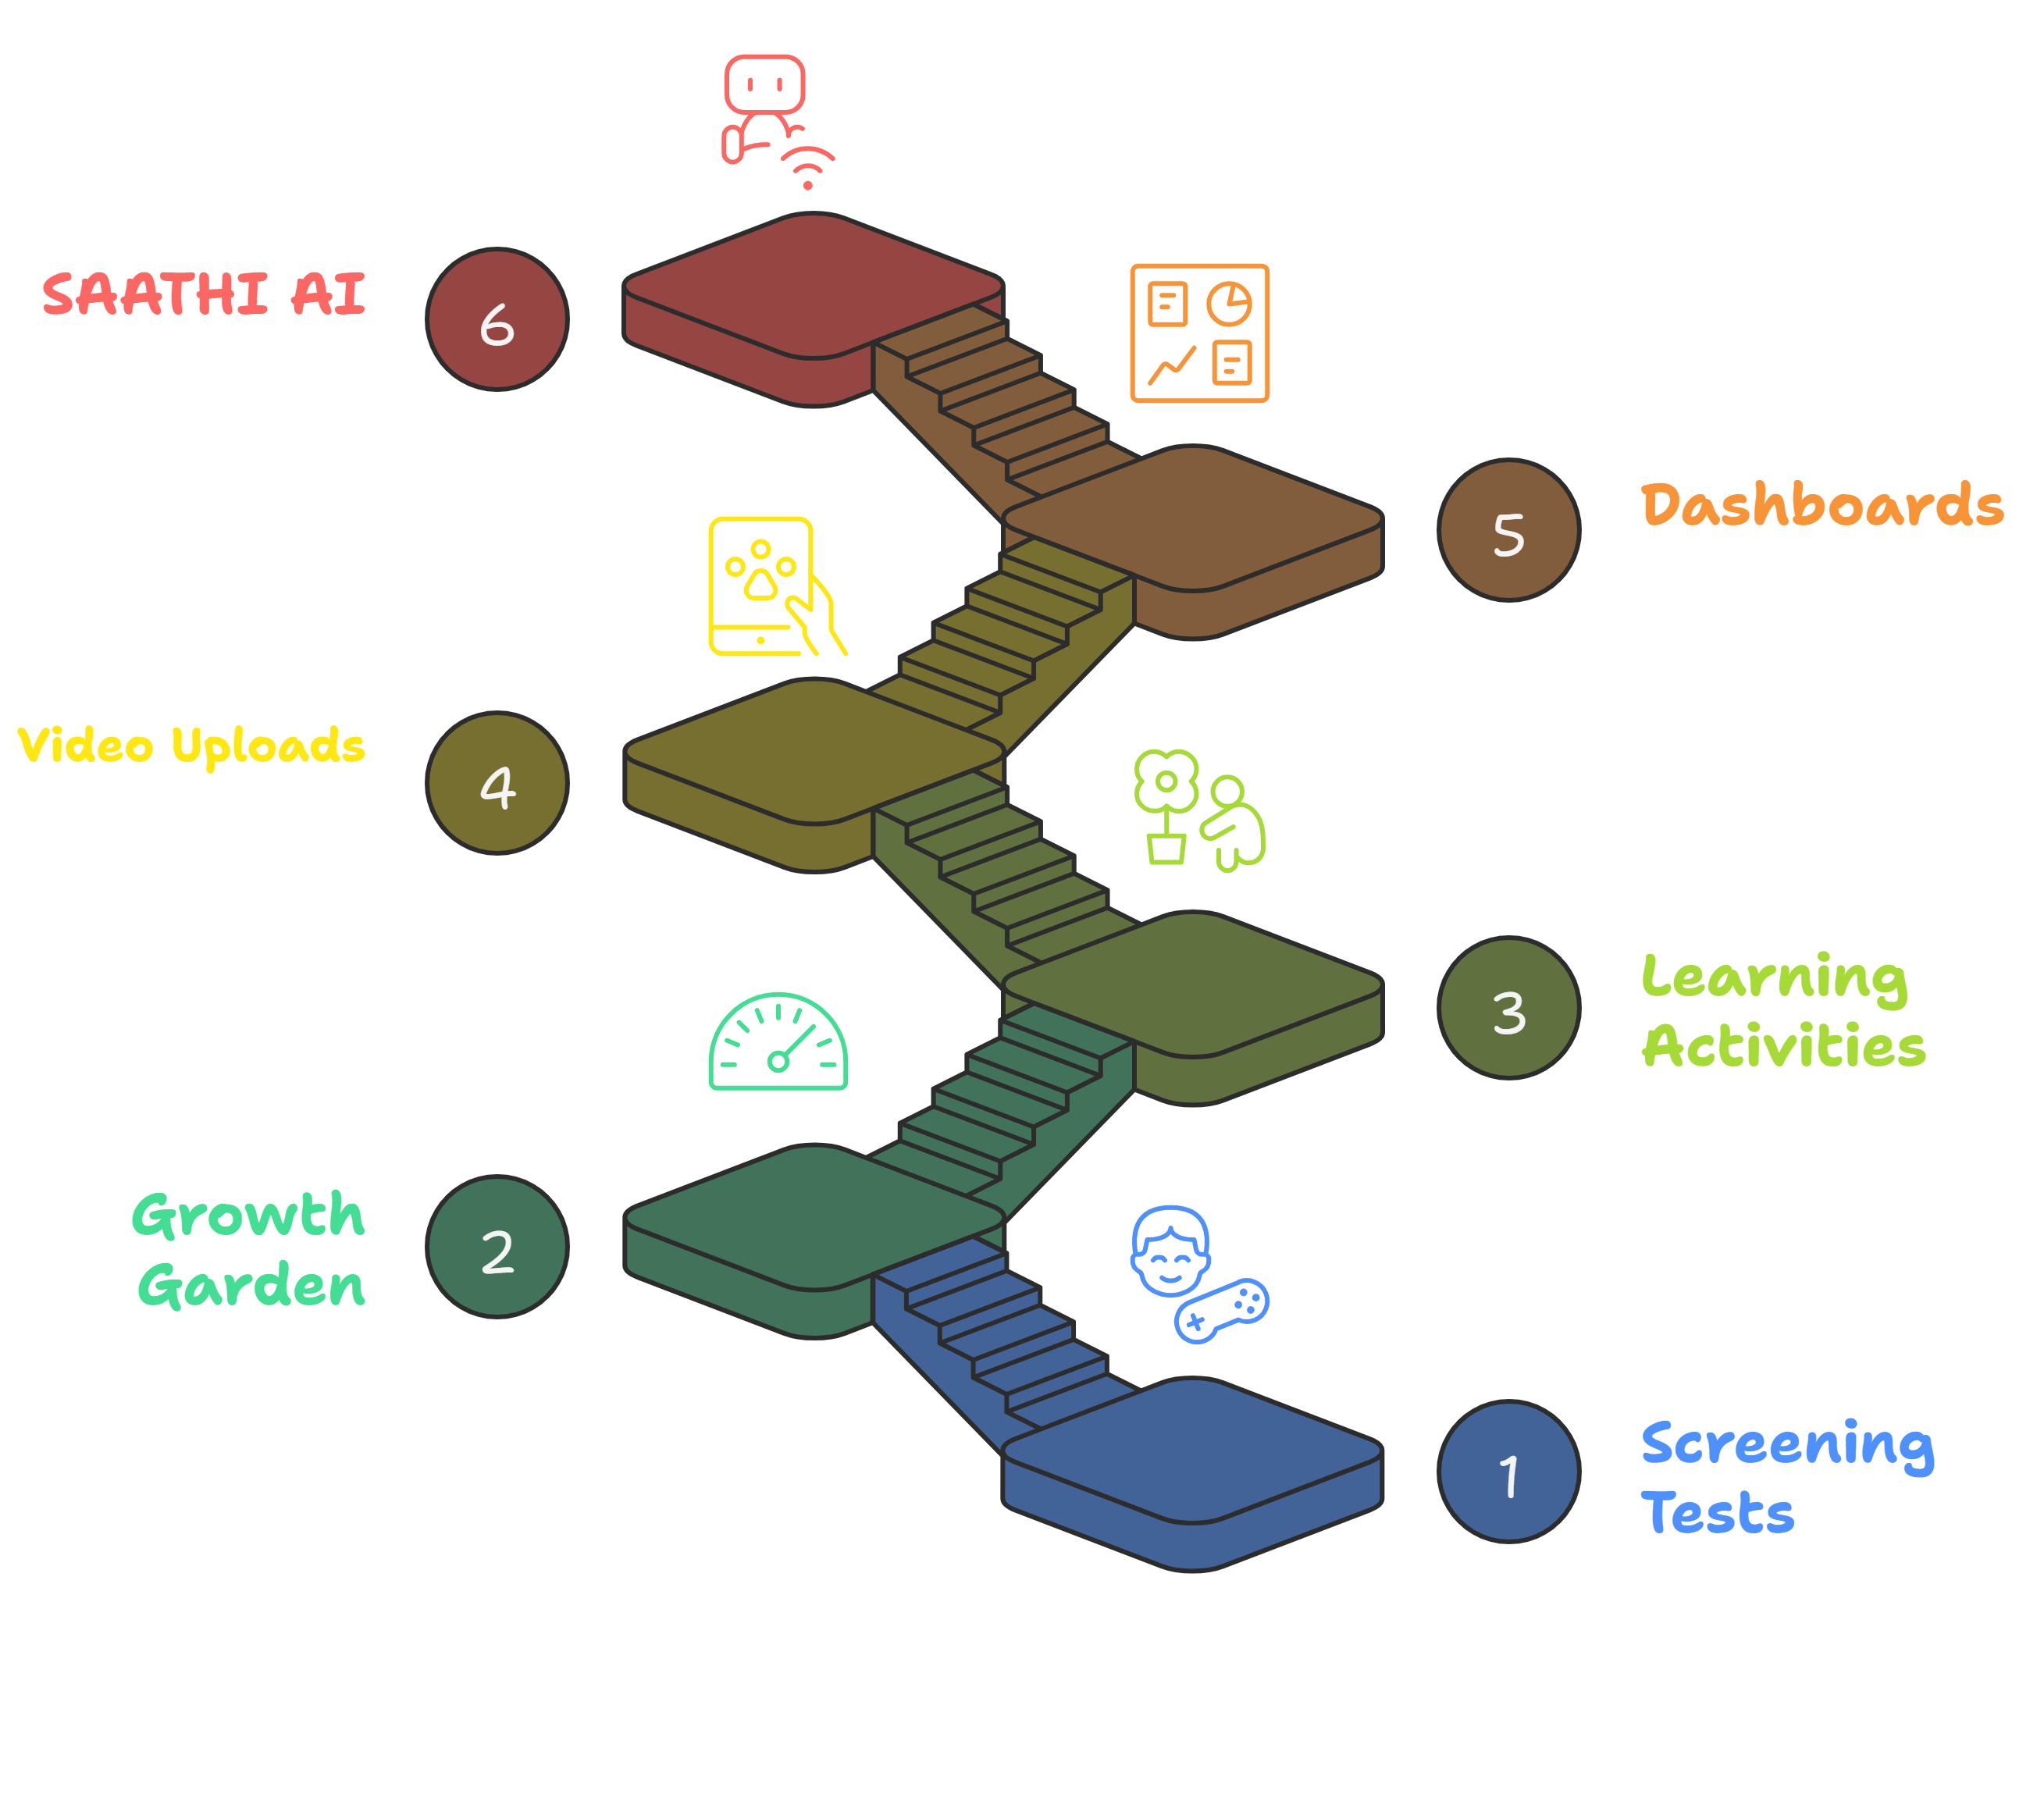
















TECHNICAL APPROACH
Return 0
Technologies to be Used:
Frontend: React.js, HTML, CSS, Lottie Animations
Backend: Node.js, Express.js, REST API, MongoDB
AI/ML: TensorFlow, scikit-learn, LangChain, RAG
Speech & Vision: Google Speech API, OpenCV, Transformers
Authentication: Firebase, JWT
Cloud and Deployment: AWS S3
Others: Docker, GitHub, Postman

Slide 4



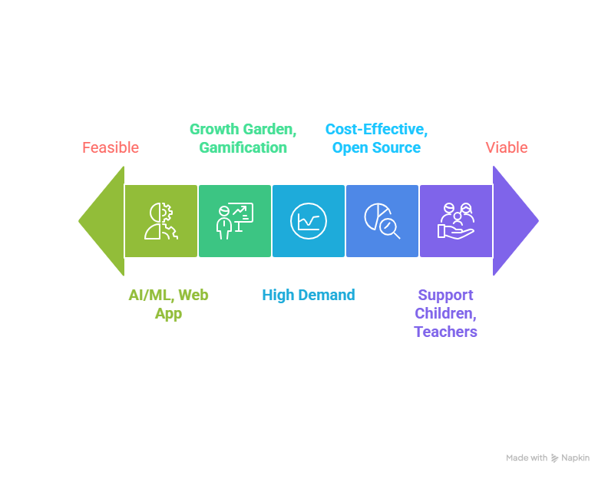



Return 0
FEASIBILITY AND VIABILITY
Feasibility
Technical – Uses AI/ML with web app, easy to build.
Modularization – Growth meter, Gamification, Saathi
Market – High demand in special education
Economic – Cost effective with open-source tools and cloud services
Use Cases
Schools use AI Growth Meter to track student learning
Parents monitor progress and upload activity videos
Experts collaborate with teachers for better results
Children engage with Saathi for emotional support
Viability
Can support children, teachers and parents together
Large user base – Useful for special schools and NGOs across India
Scalable – Start with pilot school then expand nationally
Long-term value – Continuous updates keep app engaging and relevant
Business Potential
Subscription/licensing model for school and NGOs
Partnerships with government inclusive education programs
Integration with therapy centers & special educators
Data insights for policymakers & research organizations
Challenges
AI accuracy in detecting Dyslexia/SLD/ADHD
Privacy and data security for children’s information
Adoption in rural/low tech regions
Trust and engagement from teachers and parents
Solutions
Use strong encryption and follow data protection rules to keep child’s data safe.
Offline mode for low-connectivity regions
Parent-Teacher-Expert training for adoption
Keep a dedicated tech team for regular updates and improvements.
4

Slide 5
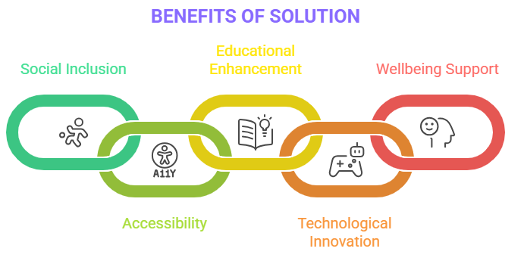
Return 0
IMPACT AND BENEFITS
Benefits of the Solution
Social:
• Promotes inclusive education for children with special needs • Raises awareness among parents, teachers, and peers • Ensures equal opportunities in classrooms
Accessibility:
• Mobile-first, easy-to-use platform
• Works across devices with low data usage • Designed for multiple learning needs and disabilities
Educational:
• Improves learning outcomes for Dyslexia/ADHD/SLD students • Provides AI-driven insights and progress tracking for teachers • Strengthens collaboration among parents, teachers, and experts
Technological:
• Leverages AI/ML for personalized learning paths • Gamified features keep children motivated and engaged • Growth Meter tracks real-time progress effectively
Wellbeing:
• Emotional support through Saathi AI ChatBot • Boosts confidence, reduces loneliness, builds resilience • Encourages socio-emotional and mental growth
Potential Impact on the Target Audience
Children with special needs – Better learning outcomes, more confidence
Parents – Stronger engagement and awareness
Teachers – Reduced workload, better support
Schools & NGOs – Scalable, affordable adoption
Society – Inclusive education and reduced dropouts
5

Slide 6
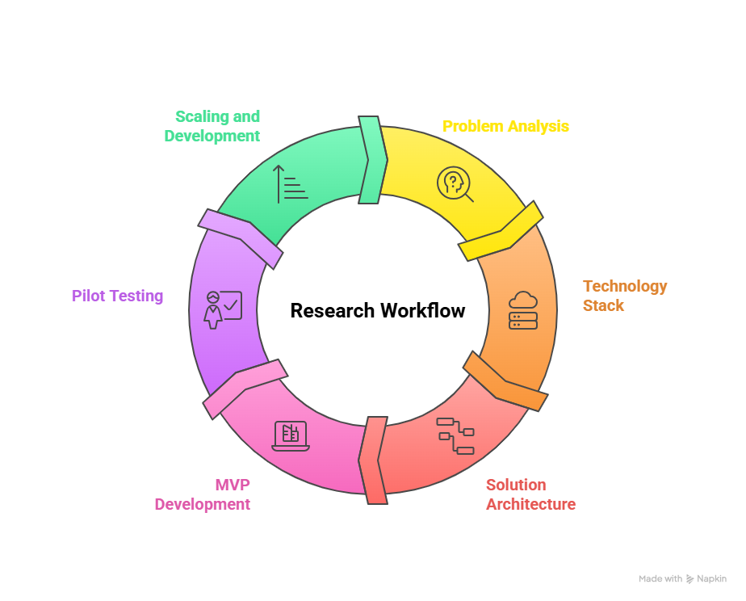
RESEARCH AND REFERENCES
Return 0
References:
Comparison with Existing Systems
Data Sources:
Ministry of Education – https://www.education.gov.in/
Help4Special – https://www.help4special.com/
CerAbility – https://www.cerability.com/
NIPPID (National Institute for the Empowerment of Persons with Intellectual Disabilities) – https://niepid.nic.in/
Research & Best Practices:
NEP 2020 – Focus on Inclusive & Equitable Education
“IJNRD2403021” – Research paper on inclusive education / special needs — https://www.ijnrd.org/papers/IJNRD2403021.pdf
Feature | Our Solution | Google Classroom | Byju’s / EdTech | DIKSHA
AI Growth Meter | ✅ | ✘ | ✅ | ✘
Saathi (AI Buddy) | ✅ | ✘ | ✘ | ✘
Gamified Learning | ✅ | ✘ | ✅ | ✘
Parent–Teacher–Expert Link | ✅ | ✘ | ✘ | ✘
Special Needs Personalization | ✅ | ✘ | ✘ | ✘
Multi-language Support | ✅ | ✘ | ✅ | ✅
Inclusive Education Alignment | ✅ | ✘ | ✘ | ✅

